Slide 1
Real-time Face Mask Detection using TensorFlow Object Detection API
Robin Manchanda (100811316)

Slide 2
Motivation
In this phase of the world where it is extremely critical in wearing masks to prevent the communicable diseases
It is necessary to set up certain measures to curb the further spread
Wearing of masks will prevent most of the chances of contracting the disease
However, people are not aware of the consequences and appear to roam without masks

Slide 3
Problem Statement
As the Coronavirus resurfaces, it is vital to wear a mask to prevent the virus from spreading. People, on the other hand, appear to be unaware of the repercussions and appear to be roaming around without masks.
To overcome this, we can have a real-time object detection system which can alert the system when it captures a person without any mask.

Slide 4
Capture Images
A script has been written using OpenCV to capture mask and no mask images with webcam.
Then, these images are randomly selected using numpy.random.choice attribute, and moved to train and test directories using shutil library.

Slide 5
Preparing the Dataset
Annotate the Dataset
LabelImg has been used to annotate the dataset
After installing LabelImg and the images of both with face mask and without facemask are collected and then annotated using the following command
labelImg <PATH_TO_TF>/TensorFlow/workspace/face-mask-detection/images
Partition the Dataset
Once the data is annotated, it is split into train and test.

Slide 6
Installation
We need to install the following libraries,
TensorFlow
  (See TensorFlow Installation)
TensorFlow Object Detection API
  (See TensorFlow Object Detection API Installation)
  Protobuf
  Cudnn/Cuda

Slide 7
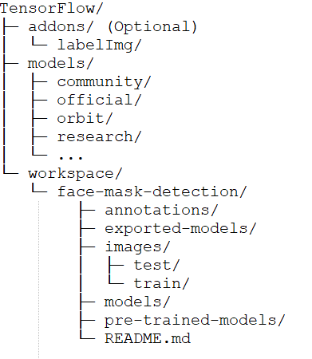
Preparing the workspace
After the installation of TensorFlow, a workspace is setup with the name of the module along with the other required folders.

Slide 8
Label Map
Create Label Map
item {
id: 1
name: ‘mask'
}
item {
id: 2
name: ‘nomask'
}

Slide 9
Tensorflow Records Files
Create TensorFlow Records
Convert *.xml to *.record
A simple script is created which can
  iterate through all *.xml files in the face-mask-detection/images/train and face-mask-detection/images/test folders,
  and generate a *.record file for each of the two. Here is an example script that allows us to do just that:

Slide 10
Configuring a Training Job
For the purpose of this project, we are not building the detection model from scratch instead we are going to leverage the transfer learning concept.
Ware using SSD MOBILENET V2 FPN 320*320, as this model provides good detection speed for our real time detection and also provides good mean accuracy performance. TensorFlow 2 Detection Model Zoo

Slide 11
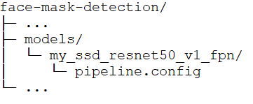
Configuring the Training Pipeline
Configure the Training Pipeline
The pipeline.config file from the downloaded model is configured:
num_classes
batch_size
fine_tune_checkpoint
fine_tune_checkpoint_type
label_map_path
Train & Test record path

Slide 12
Training the Model
The changes we have made in pipeline.config file are stored in the structure described in the last slide
After copying the model_main_tf2.py file from Tensorflow package to workspace and running the following command will train the model.
python model_main_tf2.py --model_dir=models/my_ssd_resnet50_v1_fpn --pipeline_config_path=models/my_ssd_resnet50_v1_fpn/pipeline.config

Slide 13
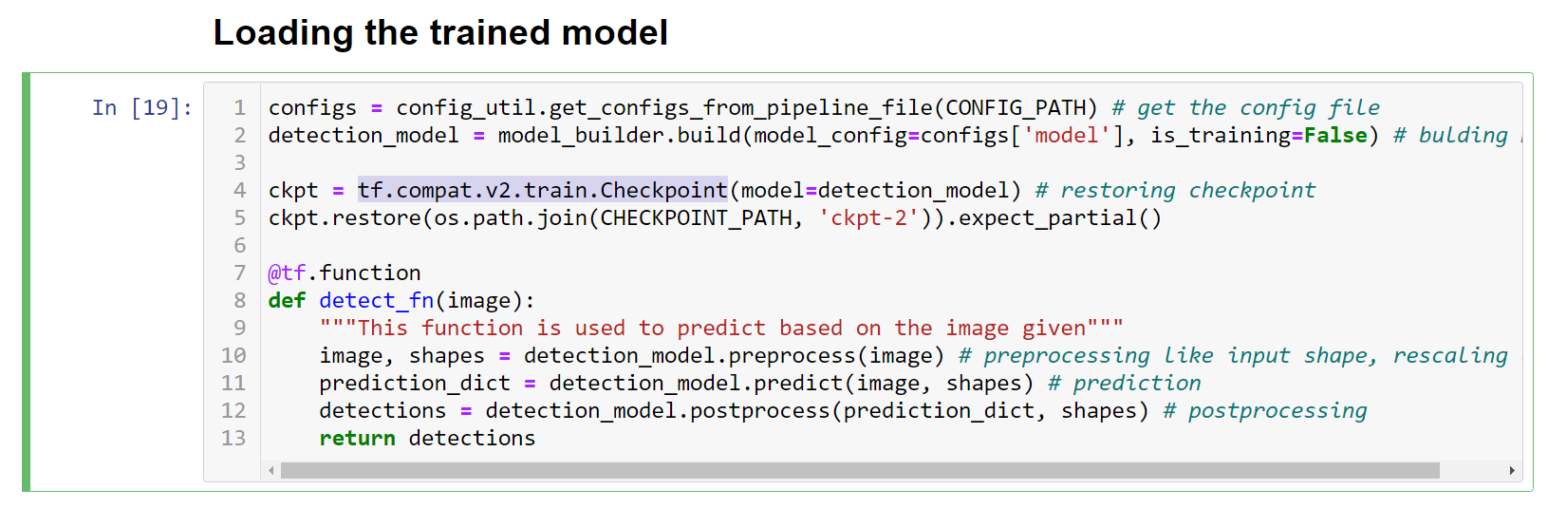
Load the trained model
The model that is trained is restored from the checkpoints.

Slide 14
Real-time detection
Now, it’s time to see the model in action.
A script has been written that is used to initialize camera, reading frame, converting the image to array and then tensor.
viz_utils.visualize_boxes_and_labels_on_image_array is used to setup the boxes, scores and labels on screen.
Real-time detection of face mask is done custom Tensorflow object detection model.

Slide 15
References
TensorFlow 2 Object Detection API tutorial, retrieved from https://tensorflow-object-detection-api-tutorial.readthedocs.io/en/latest/
Pre-trained model downloaded from https://github.com/tensorflow/models/blob/master/research/object_detection/g3doc/tf2_detection_zoo.md
Nicholas Renotte, https://www.youtube.com/watch?v=yqkISICHH-U&t=17274s

Slide 16
Thank You!

